Slide 1
2020 Lymphoma Coalition Global Patient Survey on Lymphomas and CLL
NETHERLANDS

Slide 2
Survey Background
Lymphoma Coalition (LC) launched its first Global Patient Survey (web-based) on lymphomas and CLL in 2008. Since then, it has been conducted every two years.
The survey seeks to understand patient experience in lymphomas as well as the impact of treatment and care.
LC and its global members use results to ensure patient voices are heard and to drive planning, actions and support.
Picker is an international charity dedicated to ensuring the highest quality health and social care for all, always. Picker were commissioned by LC to run their 2020 Global Patient Survey (GPS) on lymphomas and CLL.

Slide 3
Survey Methodology
The 2020 survey was redesigned via consultation between Picker, LC and its members.
Countries who had 100+ responses to the 2018 survey were able to add up to five questions that were asked only to those in that country, and responses are only included in those country specific reports.
In addition to the patient survey, a caregiver version of the survey was made available.
The English questions were translated into 18 languages by an approved language translation service.
The survey was scripted, tested and hosted on Qualtrics (Provo, UT).
The survey was published and available online 13 January 2020 until 13 March 2020.
The data were categorised and visualised into frequency tables and charts within Qualtrics, before being explored into reports for researcher interpretation and commentary.
A country-specific report was written for 18 countries with 100+ patient responses. Other reports written include: Global, Europe, Asia-Pacific, and two subtype reports (WM and CLL/SLL).

Slide 4
Survey Content
I. Patient Survey
II. Caregiver Survey
Demographics
Information, guidance and support
Physical and medical side effects of diagnosis and treatment
Fatigue
Psychosocial effects of diagnosis and treatment
Fear of cancer relapse
Barriers to treatment
Demographics
Information, guidance and support
Impact of caregiving

Slide 5
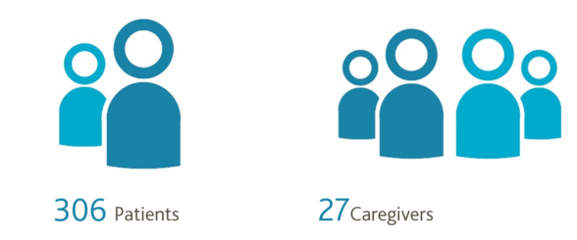
Respondent Demographics
A total of 306 responded to the patient survey and 27 to the caregiver survey.

Slide 6
Respondent Demographics (Patients & Caregivers)
Sex of patients/ gender of caregivers
Age range of respondents

Slide 7
I. Patient Survey Results

Slide 8
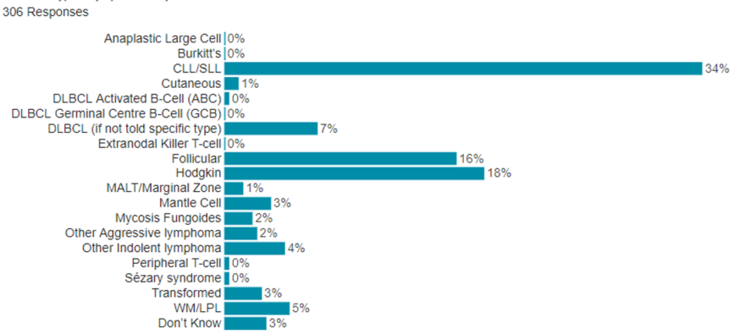
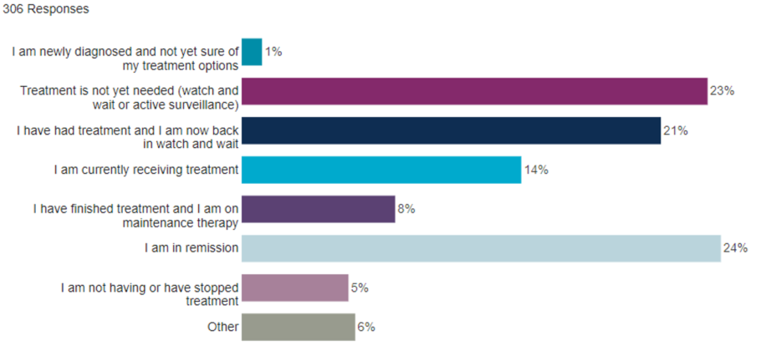
Patient Diagnostic Demographics
What subtype of lymphoma do you have?
What statement best describes where you are in the lymphoma/ CLL experience?
Abbreviations: CLL/SLL- chronic lymphocytic leukaemia/small lymphocytic lymphoma; DLBCL- diffuse large B cell lymphoma; MALT- mucosa associated lymphoid tissue; WM/LPL- Waldenström's macroglobulinaemia/ lymphoplasmacytic lymphoma

Slide 9
Patient Survey: Information, Guidance & Support
How do you feel about the amount of information you were given around the time you were first diagnosed with lymphoma?
When asked about information needs:
41% of patients reported they needed more information about treatment options
39% required more information about side effects from treatment
37% needed more information about diagnosis and what it means
When patients were asked to select their top three places to go for information about their healthcare, the following were reported as their top place to go:
76% doctor
11% websites
6% patient organisation

Slide 10
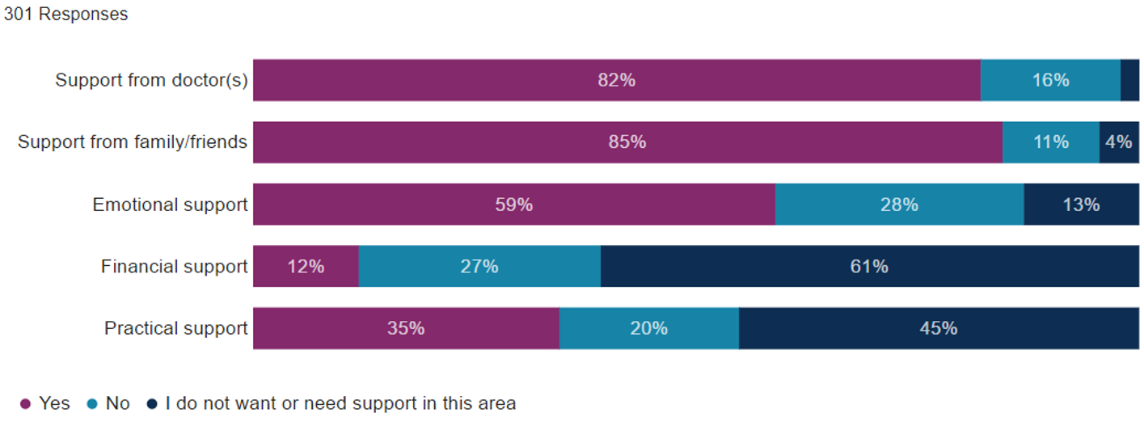
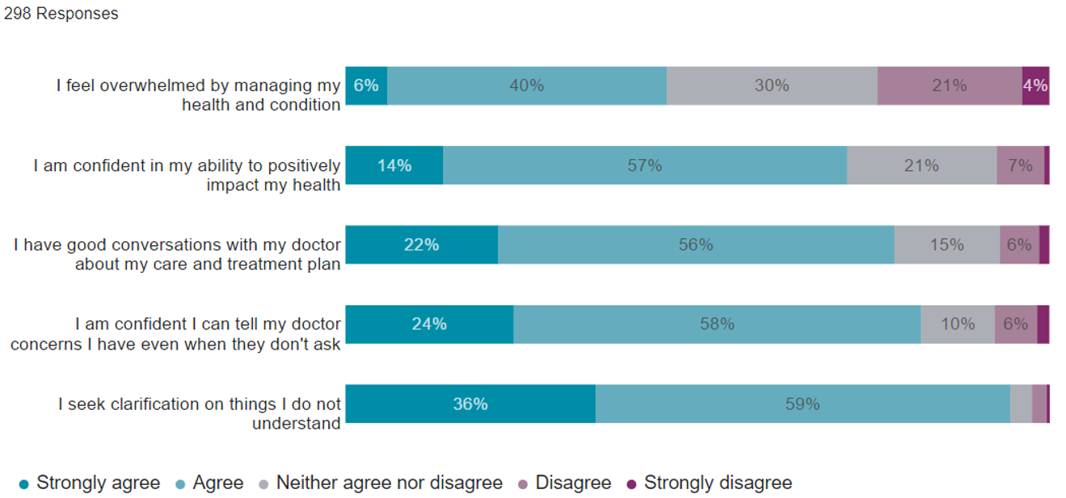
Patient Survey: Information, Guidance & Support
In general, have you received enough support throughout your patient experience in the following areas?
Thinking about your role in making decisions about your healthcare:
How confident are you that you can manage your health problems day-to-day?

Slide 11
Patient Survey: Physical & Medical Side Effects
The five most reported symptoms of lymphoma/CLL were:
Fatigue (79%)
Shortness of breath (29%)
Fever, chills, night sweats and weight loss (B- symptoms) (27%)
Frequent or repeated infections (23%)
Skin rashes/ lesions (21%)
The five most reported side effects of treatment were:

Slide 12
Patient Survey: Physical & Medical Side Effects
You said you experienced side effects from treatment, did you discuss them with your doctor?
Was the doctor able to help with the side effects?

Slide 13
Patient Survey: Fatigue
For patients with a fatigue rating of six or more out of ten, the activities and areas most affected by their fatigue were:
General work around the home (74%)
General activity (74%)
Physical activities (74%)
Have you discussed your fatigue with your doctor over the last two years?

Slide 14
Patient Survey: Fatigue
What did the doctor do after you discussed your fatigue?
The most common reasons patients gave for not discussing fatigue with their doctor were:
They did not think anything could help their fatigue (35%)
They thought they could deal with it on their own (23%)

Slide 15
Patient Survey: Psychosocial Effects
The most reported psychosocial effects that patients had experienced in the last 12 months as a result of their diagnosis were:
Fear of progression of the lymphoma: 28%
Concerns about body image/ physical appearance: 28%
Fear of cancer relapse: 28%
Changes in relationships: 21%
Depression: 20%

Slide 16
Patient Survey: Psychosocial Effects
For each of the worries or concerns listed below that you have experienced, please indicate if you have discussed it with your doctor?
For each worry or concern that you discussed with your doctor, please indicate if the doctor was able to help?
For each worry or concern that you discussed with your doctor, please indicate if your doctor followed-up with you about these worries that you were experiencing?

Slide 17
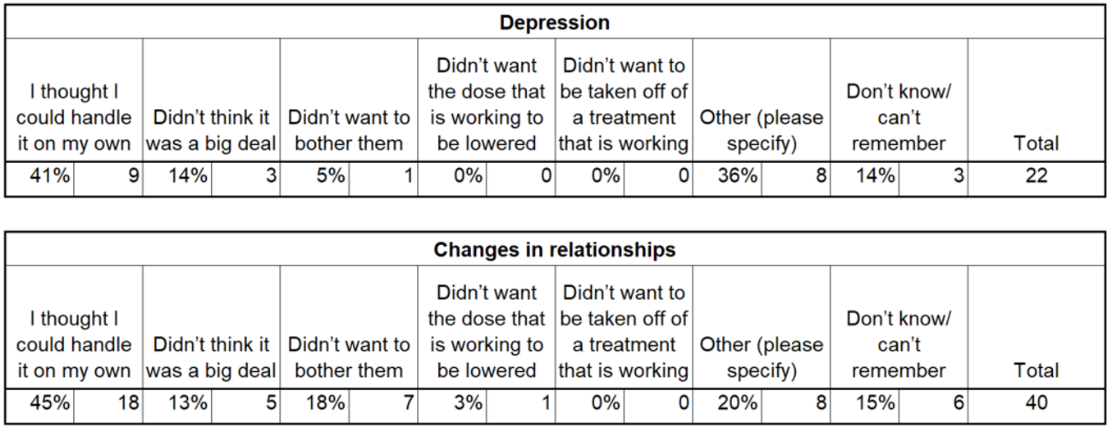
Patient Survey: Psychosocial Effects
For each worry or concern that you have experienced, please indicate what your reasons were for not discussing it with your doctor?

Slide 18
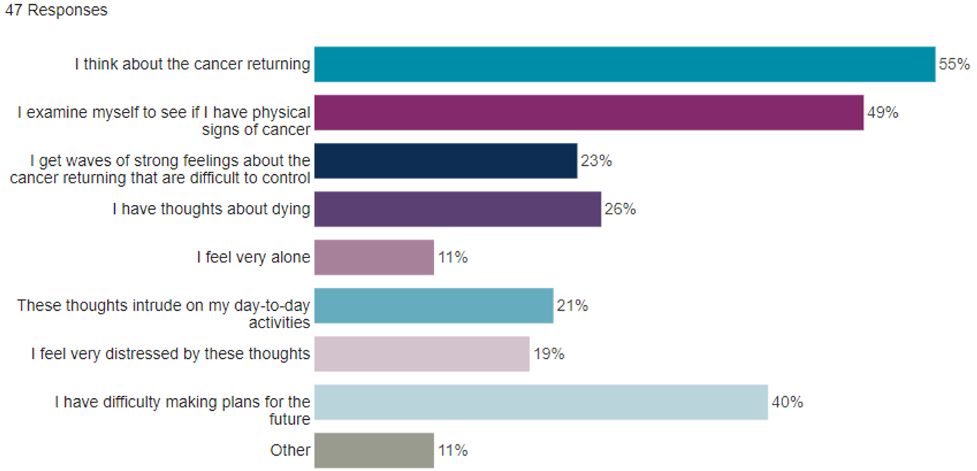
Patient Survey: Fear of Cancer Relapse
In the LC (2020) Global Patient Survey, 28% of patients reported that they experienced fear of cancer relapse in the last 12 months. 60% of those patients have discussed their fear of relapse with their doctor.
Which of the following have you experienced as a result of your fear of relapse?
Was the doctor able to help with your fear of relapse? (answered by those who had discussed it with their doctor)

Slide 19
Patient Survey: Fear of Cancer Relapse
Did your doctor follow-up with you about your fear of relapse? (answered by those who had discussed it with their doctor)
Of those patients who did not discuss fear of relapse with their doctor, 34% reported this was because they thought they could handle it on their own.

Slide 20
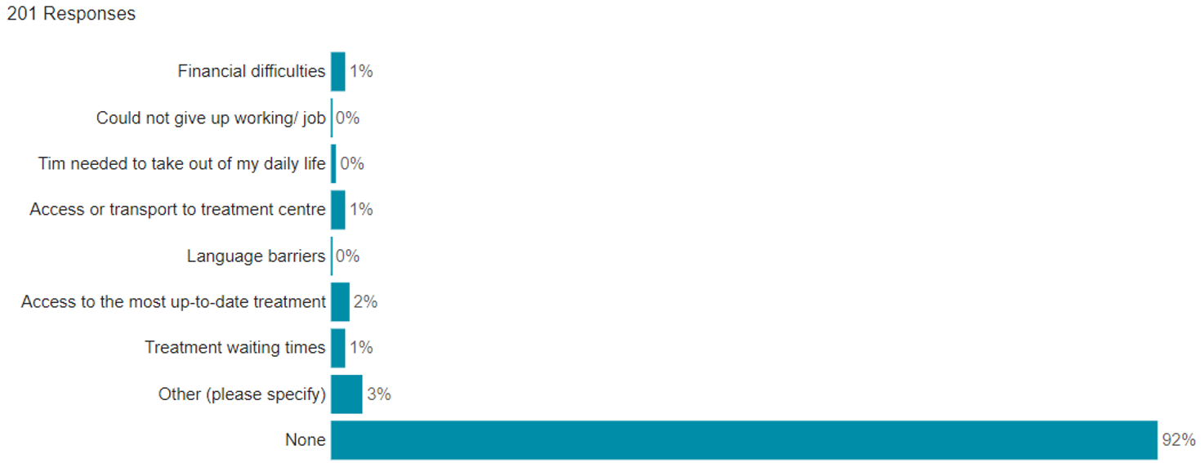
Patient Survey: Barriers to Treatment
Have any of the following prevented you from receiving treatment?
36% of patients found they had never been presented with an opportunity to take part in a clinical trial. 29% reported the barrier to being in a clinical trial was that they were not eligible or were not selected.

Slide 21
II. Caregiver Survey Results

Slide 22
Caregiver Survey: Relationship to Patient
What is your relationship to the person you are providing care and support to?

Slide 23
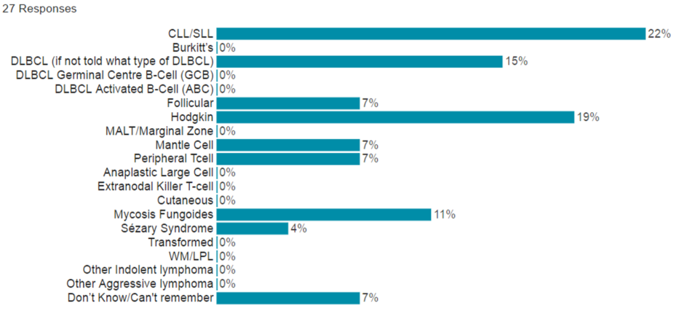
Caregiver Survey: Diagnostic Demographics
What subtype of lymphoma/CLL does/did the person you care for have?
How long have you been providing care and support to the person with lymphoma or CLL?
Abbreviations: CLL/SLL- chronic lymphocytic leukaemia/small lymphocytic lymphoma; DLBCL- diffuse large B cell lymphoma; MALT- mucosa associated lymphoid tissue; WM/LPL- Waldenström's macroglobulinaemia/ lymphoplasmacytic lymphoma

Slide 24
Caregiver Survey: Information, Guidance & Support
Following the diagnosis, who was seeking out information and details about the disease and potential treatments?
When caregivers were asked to select their top three places to go for information about their healthcare, the following were reported as their top place to go:
Doctor: 83%
Patient organisation: 9%
Nurse (4%) and websites (4%)

Slide 25
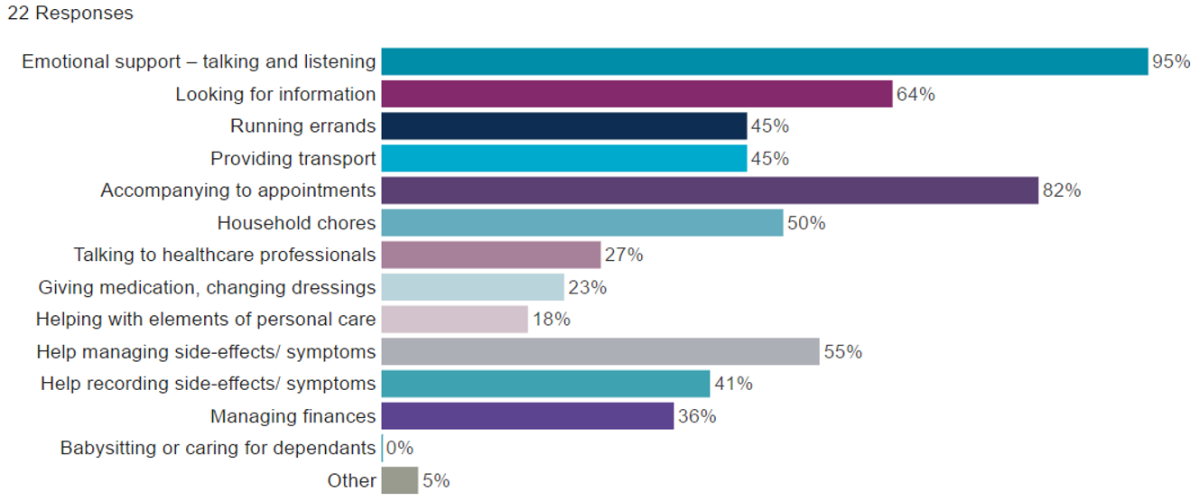
Caregiver Survey: Impact of Caregiving
Below are some elements of ‘caring’ that others providing care and support to somebody with lymphoma/CLL have mentioned. Please select what type(s) of care that you provide:
Caregivers were asked which type of care and support they find the hardest to provide:
64% reported emotional support
9% reported practical support
5% reported financial support

Slide 26
Caregiver Survey: Impact of Caregiving
Regarding the extent to which various issues have affected caregivers in the past 12 months:
75% often/always had to take time off work
64% reported that they often/always fear that the cancer of the person they care for will relapse
50% reported that they are often/always worried or anxious

